Slide 1

Mestrado em Engenharia Informática Ana Paula Oliveira Henriques
Advisors: Professor Doctor Cristina Santos, Doctorate Student Cristiana Pinheiro
Combining a virtual reality-based environment with mirror training to improve movement
December 2024

Slide 2
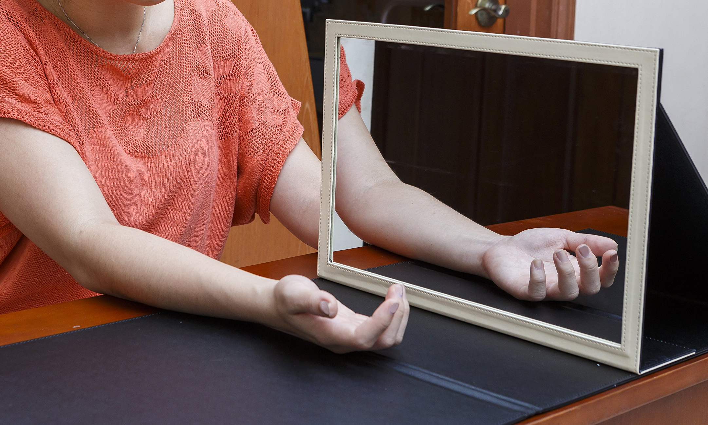
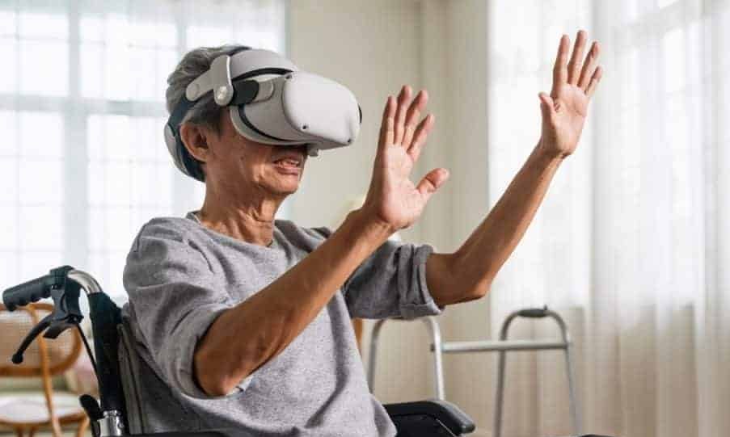
Motivation & Problem Statement
7-10M
cases of Parkinson worldwide, estimated to increase by 80% in the next two decades.
MIRROR THERAPY (MT)
with action observation (AO), motor imagery (MI) and motor execution (ME) with feedback in real-time.
Main symptoms of Parkinson’s:
Bradykinesia (slow movements);
Balance Impairments;
Tremors;
Depression and anxiety;
Dementia.
Economic consequences.
+
VIRTUAL REALITY (VR)
as a MT intermediary to intensify body control, isolated from external distractions.
=
VRMT System
Introduction
State of Art
VRMT System
Experimental Protocol
Results & Discussion
Conclusion

Slide 3
Objectives & Research Questions
DEVELOP AND VALIDATE A VIRTUAL REALITY ENVIRONMENT COMBINING MIRROR THERAPY FOR PD REHABILITATION
OBJECTIVES
INVESTIGATION
ANALYZE
IMPLEMENT
1
4
RQ1
How are MT strategies applied and what effects are reported in the literature for PD’s victims?
State of the Art
Experimental Protocol
IDENTIFY
DISCUSS
RQ2
What are the VRMT strategies described in the literature that have a positive impact on motor effects?
2
5
System Requirements
Results
DEVELOP
DOCUMENT
RQ3
How does virtually incorporating AO, MI, and real-time feedback influence biomechanical data in healthy population and a PD case study?
3
6
VRMT System
Dissertation
Introduction
State of Art
VRMT System
Experimental Protocol
Results & Discussion
Conclusion

Slide 4


State of the art (S1): Mirror therapy in Parkinson’s
RQ1
Mild to moderate symptoms;
Preserved cognitive function;
Medical stability;
Ability to walk some distance.
Parkinson’s
Patients
15 STUDIESi
On applications of mirror therapy in patients with Parkinson’s disease to evaluate its motor and non-motor effects.
2-3 sessions per week, total 4.5 weeks, 60 minutes each session;
46.7% AO+ME;
40.0% AO+ME+MI;
13.3% MI+ME;
Clinical
Protocols
General Conclusions
EFFECTIVE: AO considering the appropriate type of movement and the observational perspective;
NOT AS EFFECTIVE: MI not in combination with AO;
The combination of AO, MI and ME brings potentially lasting improvements in mobility and balance.
Motor and
Non-motor
Effects
60.0% Significant motor improvements;
26.7% Significant cognitive improvements;
20.0% Impact on quality of life;
26.7% Long-lasting effects.
Introduction
State of Art
VRMT System
Experimental Protocol
Results & Discussion
Conclusion

Slide 5
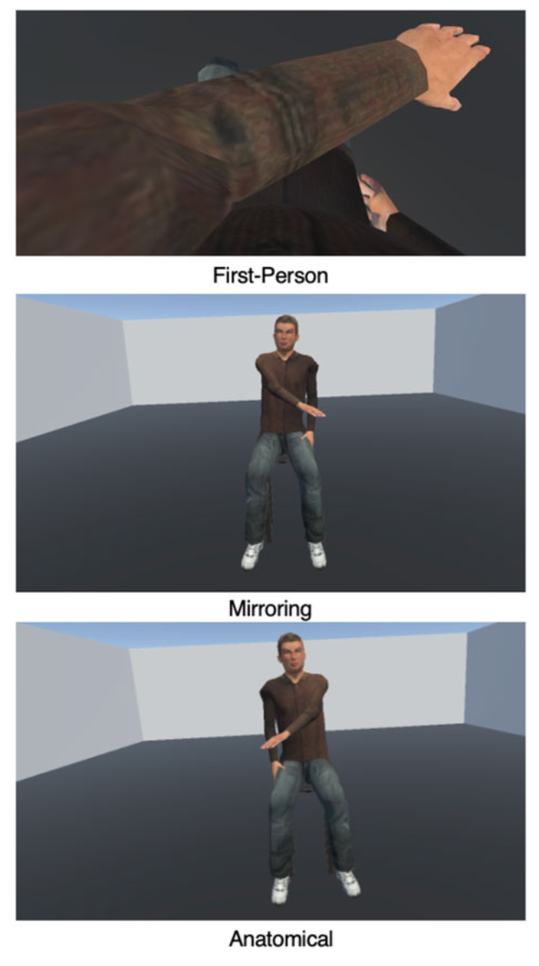

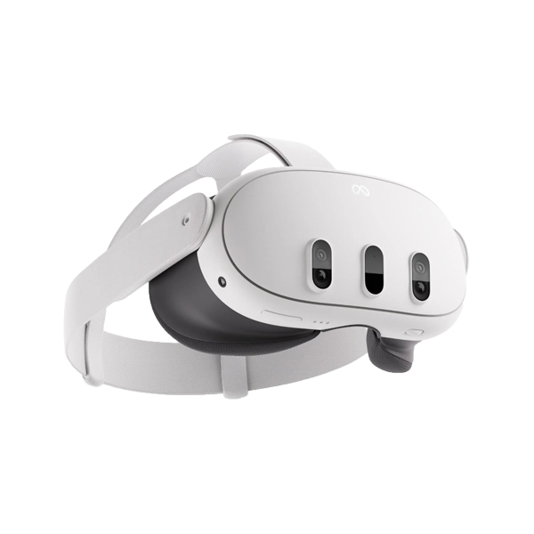
State of the art (S2): Virtual mirror therapy
RQ2
Observational Perspectives of Avatars
15 STUDIES
On applications of immersive virtual mirror therapy in various diseases that aim at motor rehabilitation.
First person
Third Person: Mirrored
Third Person: Anatomical
Sensors and VR Equipment
73.3% Head-mounted display
40.0% Motion tracking technology
33.3% EEG systems
General Conclusions
EFFECTIVE: Observing one’s own avatars, with different perspectives of observation.
VR ADVANTAGE: Easier to convert simple movements into functional tasks; more immersive therapeutic experience.
Multifaceted feedback mechanisms
33.3% Visual feedback techniques
13.3% Neurofeedback
13.3% Vibrotactile feedback
Introduction
State of Art
VRMT System
Experimental Protocol
Results & Discussion
Conclusion

Slide 6
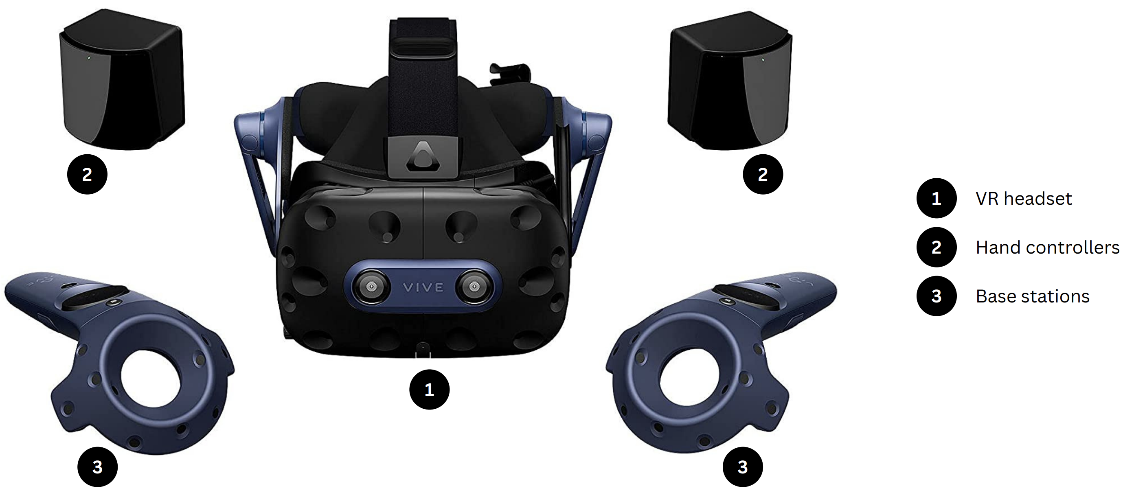
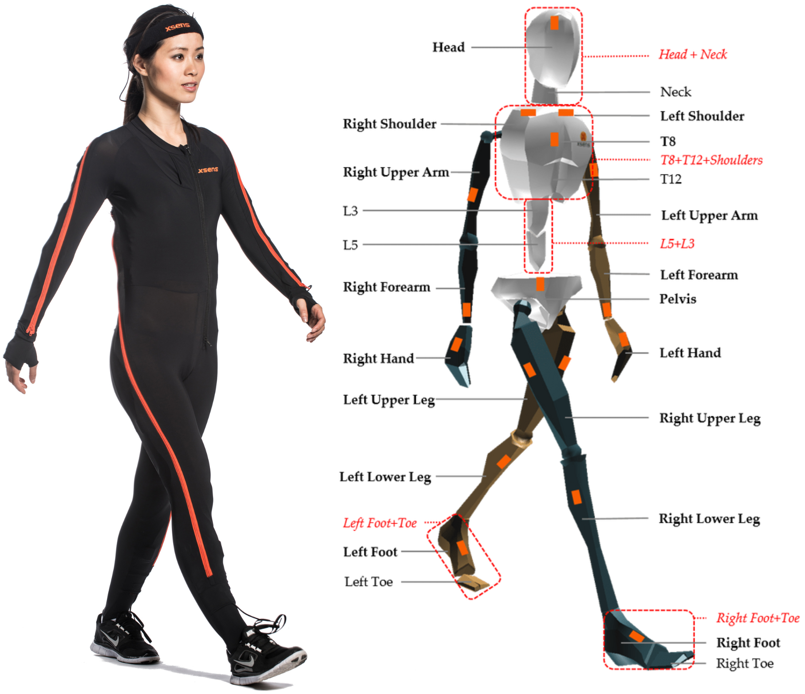
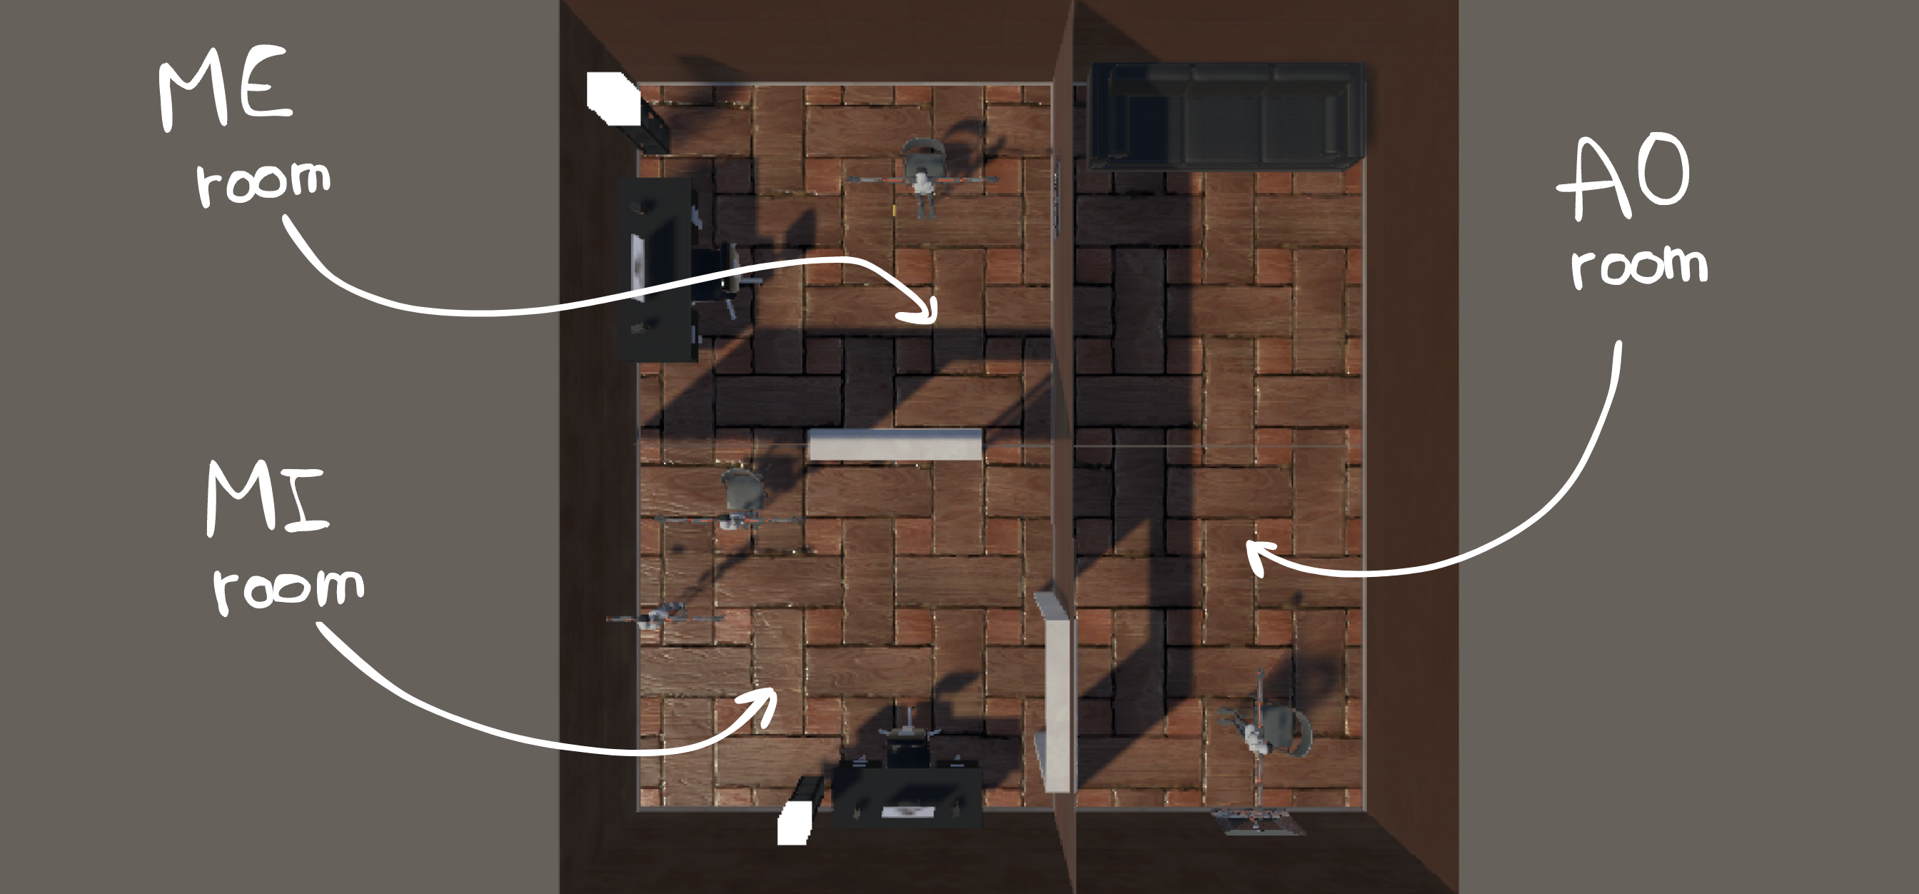
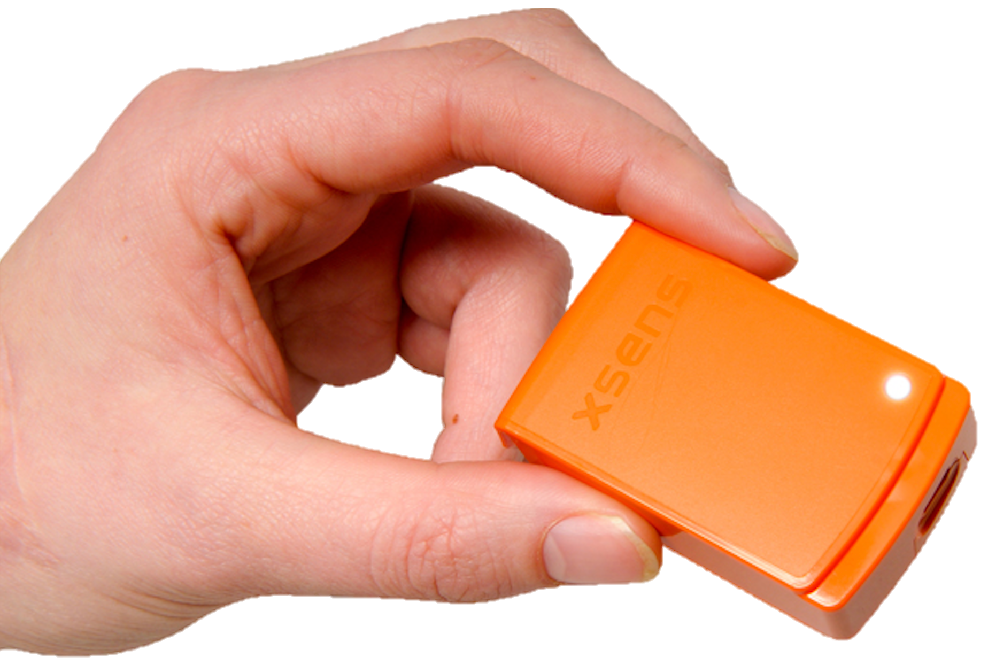






VRMT System: Equipment and virtual environment
In the virtual world, there will be personalized avatars:
During AO: a dynamic avatar for instruction;
During MI: two static avatars indicating the initial and final positions of the activity to be imagined;
During ME: an avatar for self-observation with real-time feedback.
HTC VIVE
Xsens MVN
+ Unity to develop the virtual environment
+ SteamVR to connect Unity to HTC VIVE
to manipulate the appearance of avatars
Introduction
State of Art
VRMT System
Experimental Protocol
Results & Discussion
Conclusion

Slide 7

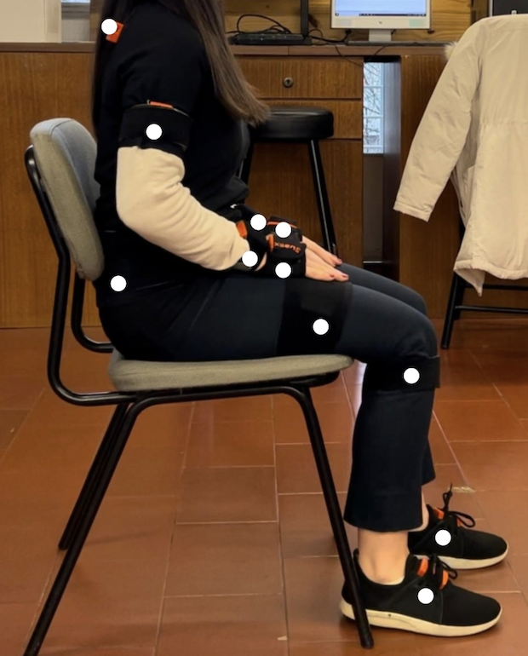
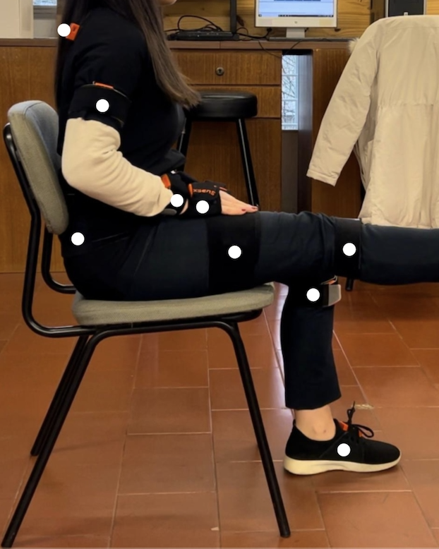
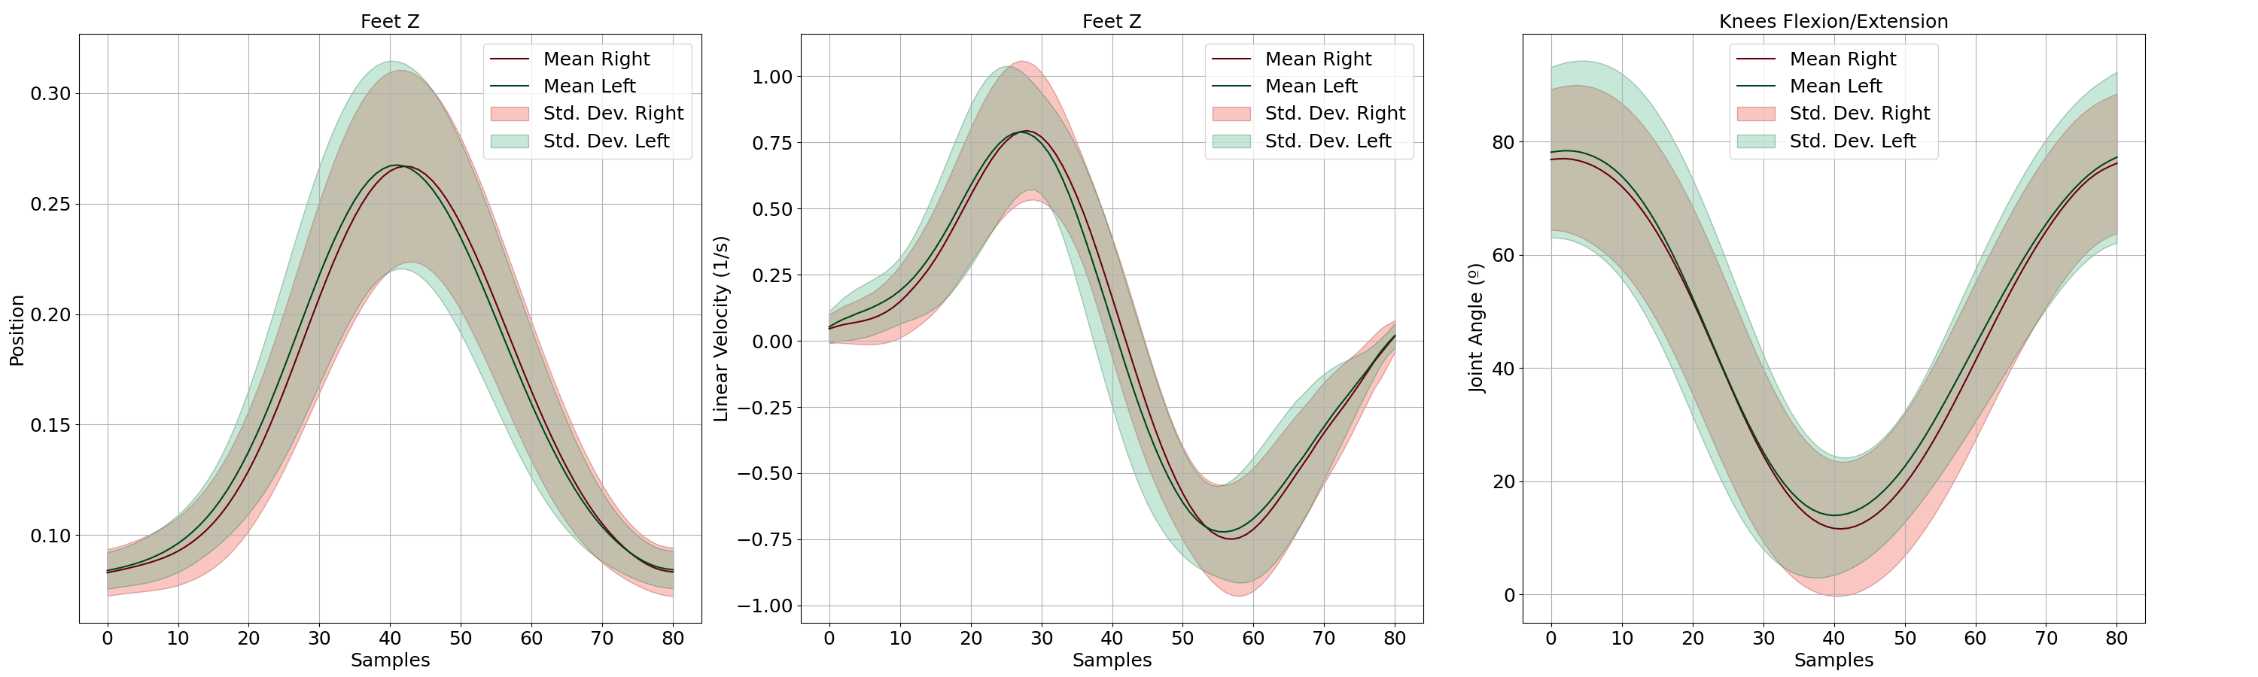
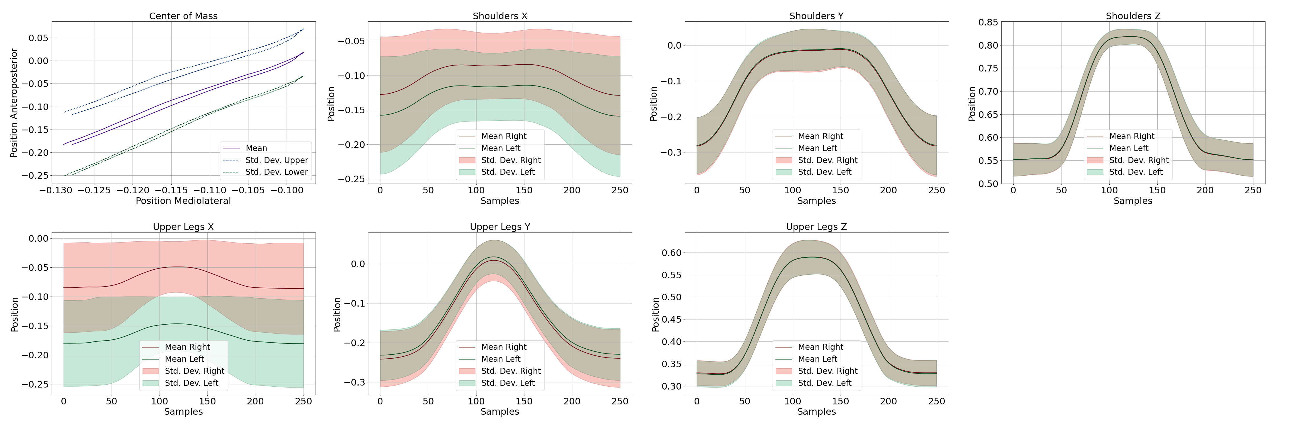
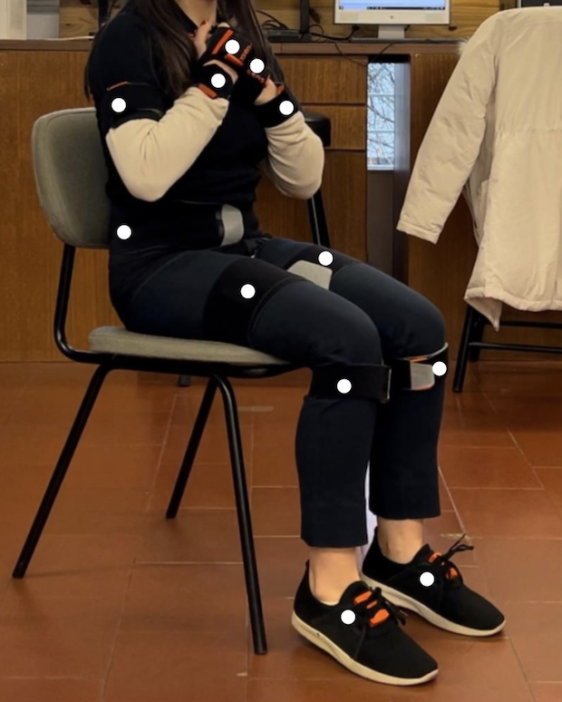
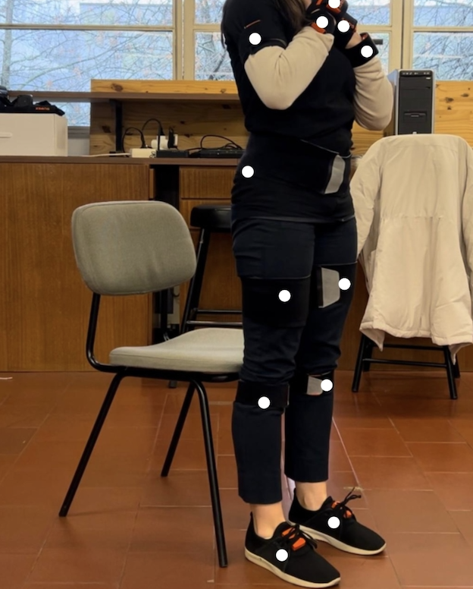
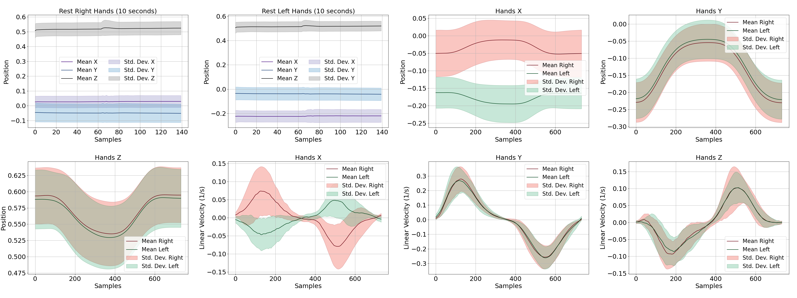
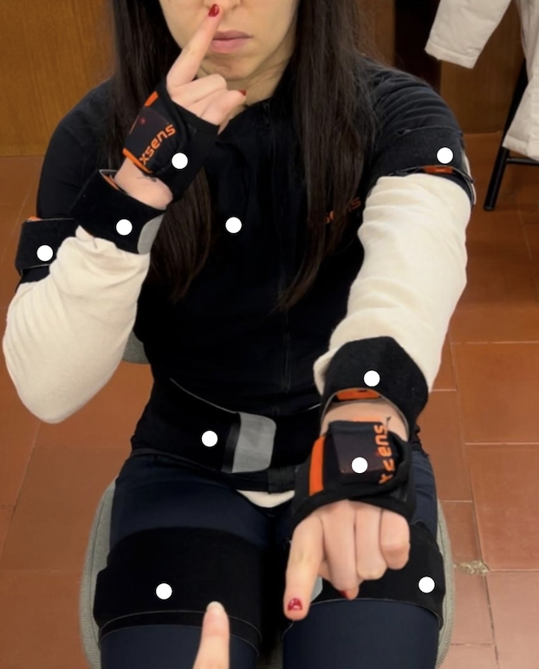
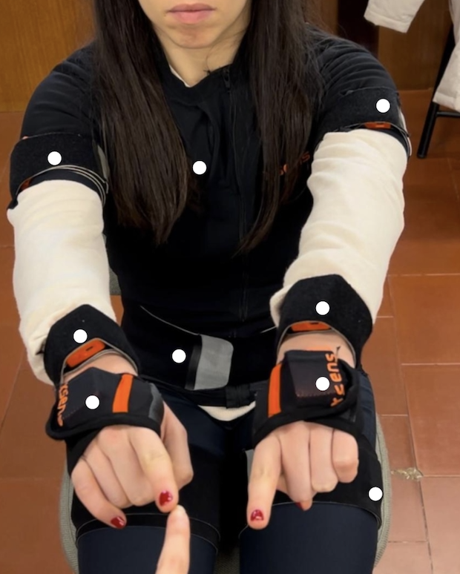
VRMT System: Reference learning data
Lifting the leg
Raising from a chair
LIFTING THE LEG
Healthy symmetry between limbs (velocity of 0.79 ±0.26 1/s and height of 0.27 ±0.04 m).​
Slow movements
RAISING FROM A CHAIR
Minimal lateral displacements of the centre of mass (-0.10 ±0.05 m to -0.13 ±0.07 m).
VARIABILITY OF THE HEALTHY POPULATION (12 participants)
Stretching arms forward for 10 seconds
Nose Touching
Lack of Balance
NOSE TOUCHING
Minimal vertical hand oscillation (0.05 ±0.02m).
STRETCH ARMS FORWARD
The hand position varied 0.06 m, i.e. no significant tremors.
Tremors
Introduction
State of Art
VRMT System
Experimental Protocol
Results & Discussion
Conclusion

Slide 8
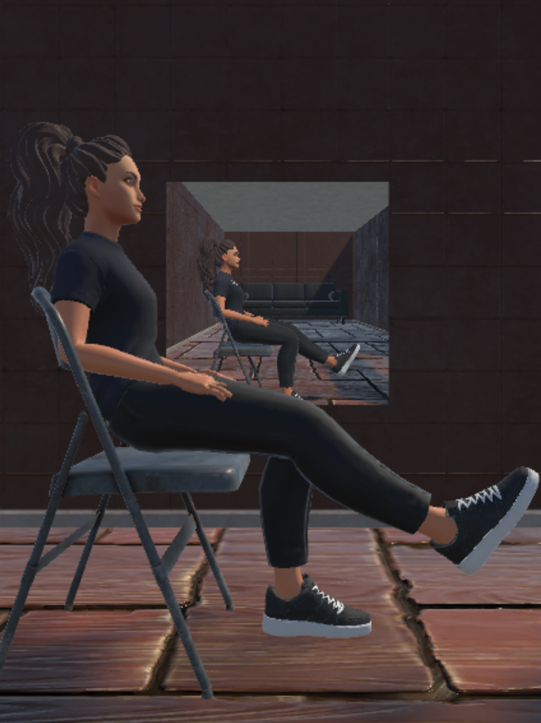
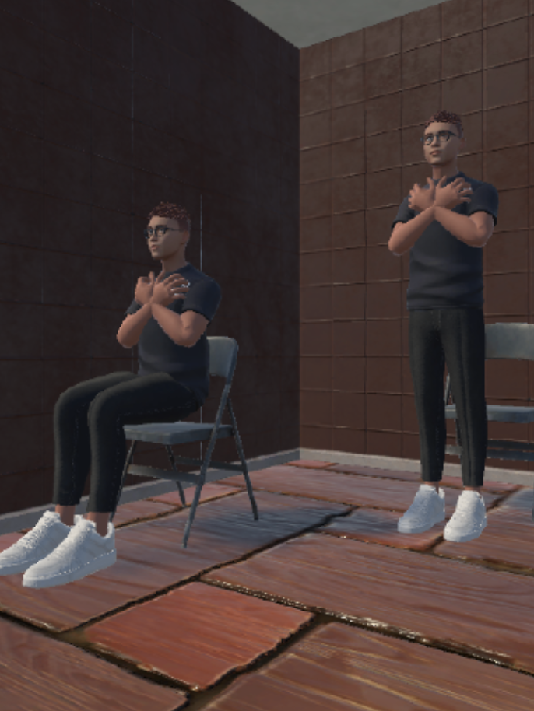
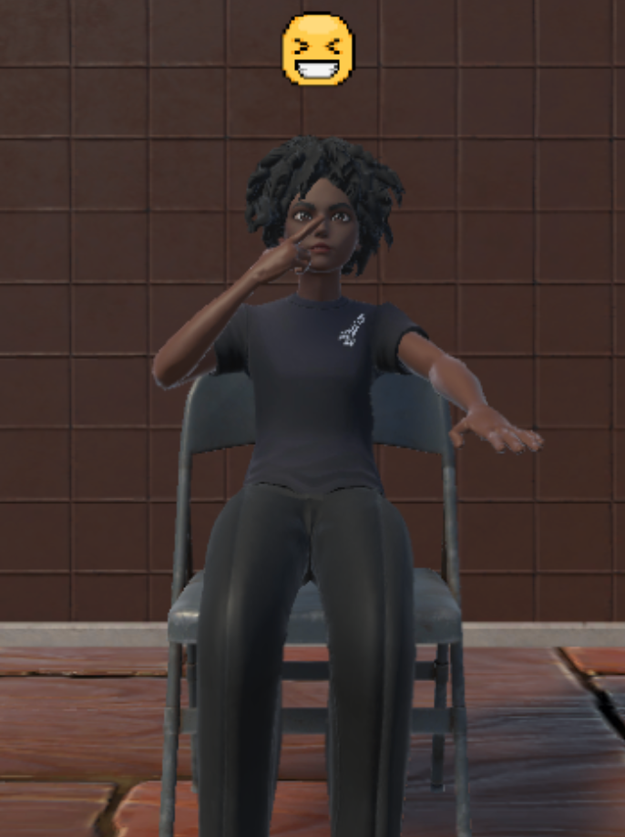



VRMT System: AO, MI and real-time feedback
During AO
During MI
During ME
Animated
Avatars
MANIPULATION OF ANIMATIONS
C# Language
Unity API
Movella.Xsens
Reference data
adjusted to Unity's biomechanical model.
FEEDBACK ALGORITHM
Reinforcement Learning
Visual (positive): Reward
Auditory (negative): Reprimand
Feedback criteria
compare the received data
with the reference data.
Avatar moving in real time
Dynamic animation created with reference data.
Static animation.
Starting and ending positions of an activity.
Moving in real time, providing visual or auditory feedback.
Introduction
State of Art
VRMT System
Experimental Protocol
Results & Discussion
Conclusion

Slide 9
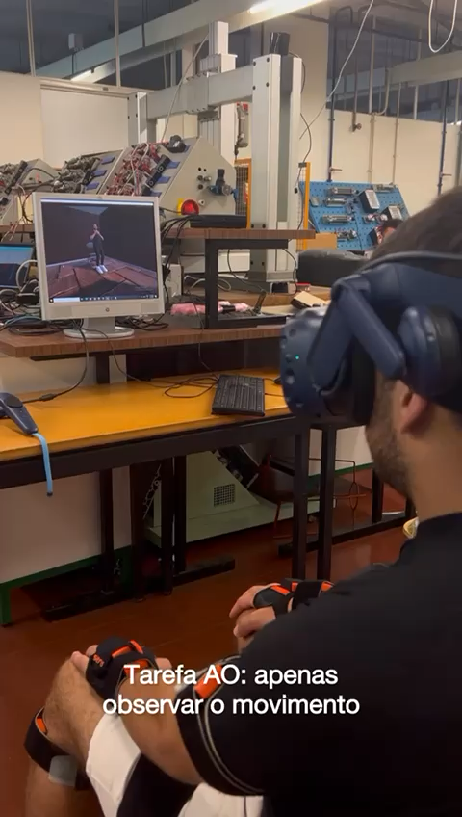
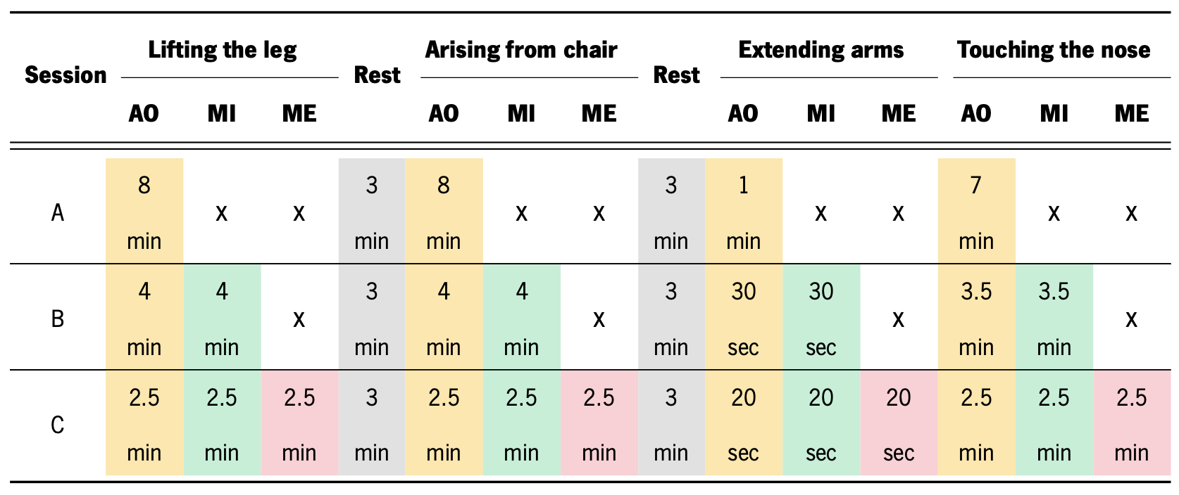
Experimental Protocol: Healthy Participants
8 healthy participants
Mean age: 23 (±2) years old
Mean height: 1.7 (±0.09) meters
DEMO
RANDOMIZED PROCEDURE,
EACH SESSION IN DIFFERENT DAYS
Total duration of 30 minutes, with 6 minutes of rest.
Data Acquisition
Lifting the leg: foot position and velocity;
Raising from chair: position of centre of mass;
Stretching arms forward: hand position;
Nose touching: hand position and velocity.
+ Answers to VR and MI questionnaires.
Data Processing
Segmentation
Interpolation
Normalization by height
Second-order high-pass filter
Mean curve and standard deviation
Introduction
State of Art
VRMT System
Experimental Protocol
Results & Discussion
Conclusion

Slide 10
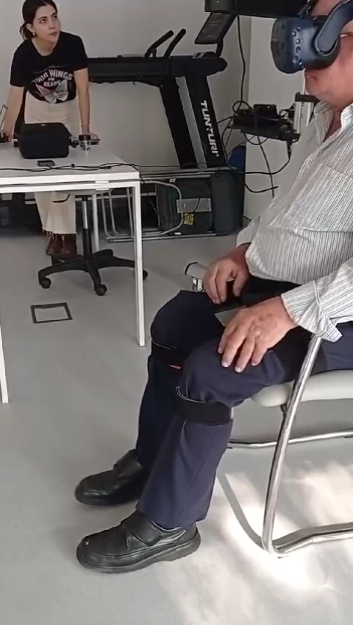
Experimental Protocol: Parkinson’s case study
Age: 67 years old
Height: 1.7 meters
Hoehn & Yahr Scale: 1.5 (Mild)
UPDRS III Scale: 25
DEMO
SESSION C ONLY, ONLY THE ACTIVITY OF LIFTING THE LEG
Total duration of 15 minutes, with a rest period 3 minutes.
UNDER PARTIAL EFFECT OF MEDICATION
Data Acquisition
Lifting the leg: foot position and velocity;
+ Answers to VR and MI questionnaires.
Only the “lift your foot more” message is heard as negative feedback.
Data Processing
Segmentation
Interpolation
Normalization by height
Mean curve and standard deviation
Introduction
State of Art
VRMT System
Experimental Protocol
Results & Discussion
Conclusion

Slide 11
Discussion of Results: Biomechanical data
RQ3
Healthy Participants
Parkinson’s Case Study
Repetitive auditory feedback triggered stress, but led to a gradual improvement in performance.
The PD patient diverged greatly from reference data derived from a younger healthy population.
Activity | Symptom | Impactful Sessions | p-value
Lifting the leg | Slow movements | Session A (just AO) Session C (AO+MI+Feedback) | <0.001
Raising from a chair | Balance Impairments | Session C (AO+MI+Feedback) | 0.489
Stretiching arms forward | Tremors | No significant changes | 0.983
Nose Touching |  | Session A (just AO) Session B (AO+MI) | 0.153
General Conclusions
POSITIVE: Virtual integration of visual stimuli and real-time feedback increases participant engagement and motor learning.
NEGATIVE: Imagery results are not as robust.
Introduction
State of Art
VRMT System
Experimental Protocol
Results & Discussion
Conclusion

Slide 12
Discussion of Results: Usability tests
IPQ and IMI Questionnaires (Virtual Reality)
KVIQ Questionnaire (Imagination)
HEALTHY PARTICIPANTS
POSITIVE:aFeedback enhances participant motivation by increasing interaction with the system.
POSITIVE: Immersive and realistic system, with potential for motor rehabilitation.
NEGATIVE: Real-time feedback increased pressure.
PARKINSON’S CASE STUDY
POSITIVE: Patient considered the system more realistic.
NEGATIVE: Motor performance did not improve.
HEALTHY PARTICIPANTS
Session C with better results in visual imagination and session B in kinesthetic imagination.
PARKINSON’S CASE STUDY
The patient had difficulty answering the MI questionnaire.
General Conclusions
Combining AO, MI and ME with real-time feedback was the most effective and motivating.
Introduction
State of Art
VRMT System
Experimental Protocol
Results & Discussion
Conclusion

Slide 13

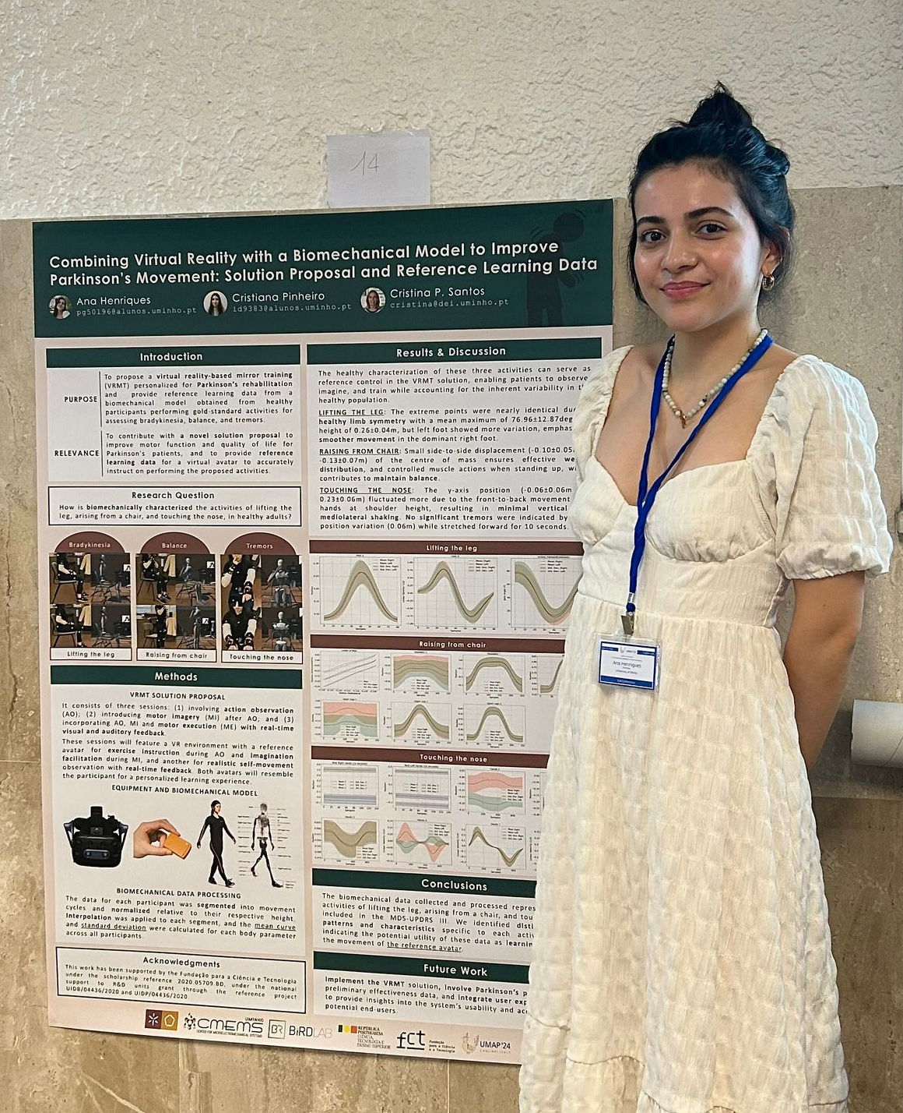
Scientific Contributions
1 Conference Paper (first author)
Ana Henriques, Cristiana Pinheiro, and Cristina P. Santos. 2024. Combining Virtual Reality with a Biomechanical Model to Improve Parkinson's Movement: Solution Proposal and Reference Learning Data. In Adjunct Proceedings of the 32nd ACM Conference on User Modeling, Adaptation and Personalization (UMAP Adjunct '24). Association for Computing Machinery, New York, NY, USA, 92–97. https://doi.org/10.1145/3631700.3664876
1 Journal Paper (under review)
July 1st, 2024
Cagliari, Italy
Introduction
State of Art
VRMT System
Experimental Protocol
Results & Discussion
Conclusion

Slide 14

Conclusions and Future work
FUTURE
FUTURE
Well-received system, with potential for motor rehabilitation
Adjust feedback to each participant's execution time
Adjust the cutoff frequency of the high-pass filter to the movement speed
FUTURE
FUTURE
Increased interaction with the system augments user motivation
Establish a feedback system with different levels of difficulty
Develop a deep learning algorithm to provide feedback during MI
Introduction
State of Art
VRMT System
Experimental Protocol
Results & Discussion
Conclusion

Slide 15
Mestrado em Engenharia Informática Ana Paula Oliveira Henriques
Advisors: Professor Doctor Cristina Santos, Doctorate Student Cristiana Pinheiro
Thank you so much for your attention.
Any questions?
December 2024

